Slide 1
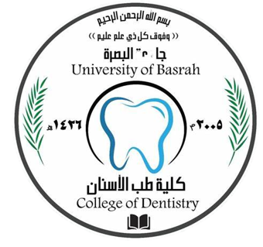
Bone Diseases of the Jaws
Dr.Sundus Abdul wadood Aljazaeri
MSc O&MFS
College of Dentistry

Slide 2
Bone Diseases of the Jaws
Bone Diseases of the Jaws will be divided in 2 main groups:
1. Odontogenic : those related to the dentition and those restricted to the bone proper. Tooth-related jaw bone diseases can be divided to:
Odontogenic cysts
Odontogenic tumors.
Odontogenic diseases
2. Nonodontogenic :
Nonodontogenic cyst
Reactive bone diseases,
fibro-osseous lesions,
Giant cell lesions,
Nonodontogenic bone tumors

Slide 3
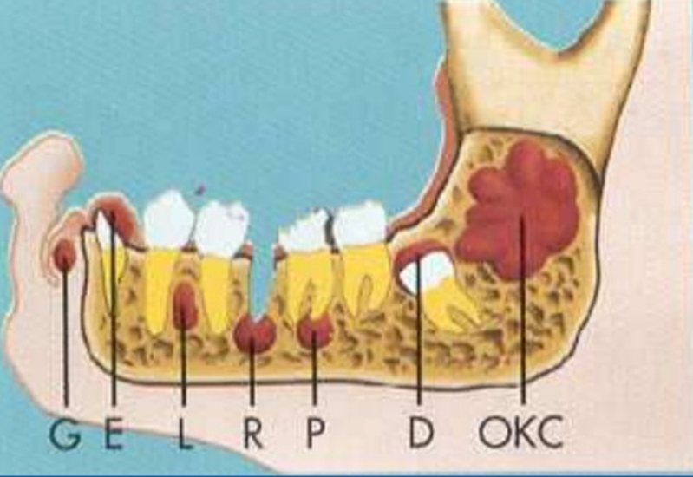
Odontogenic cysts
A- DEVELOPMENTAL CYST
Primordial cyst
Eruption
Gingival cyst
Dentigerous cyst
Lateral periodontal cyst
Odontogenic Keratocyst
Classify odontogenic cyst
B-INFLAMMATORY CYST
Radicular
Residual cyst
Paradental cyst
Collateral cyst

Slide 4
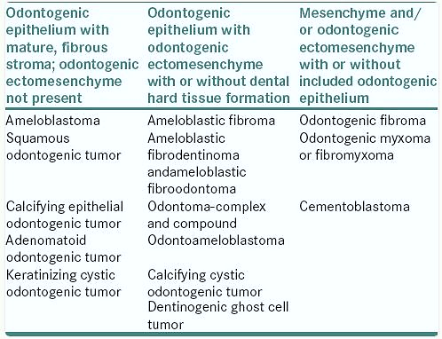
Odontogenic tumours Classifications

Slide 5
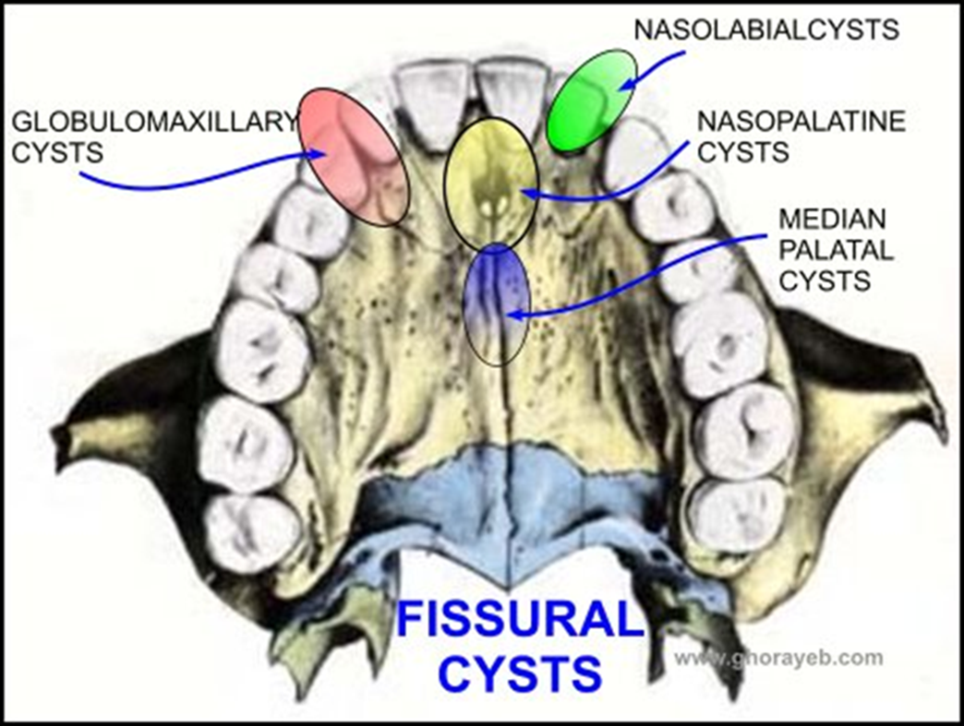
Nonodontogenic cysts
Fissural cysts
Nasopalatine
Median palatine
Median mandibular
Nasolabial
Globulomaxillary
Bony cyst
Aneurysmal bony cyst
Traumatic cyst

Slide 6
Reactive bone diseases
lesions are bony outgrowths
Tours mandibularis
Torus palatanis
Inflammatory diseases
Periapical diseases
Periodontal diseases
Osteomyelitis
Paget´s disease
Fibro-Osseous Lesions
fibrous dysplasia,
ossifying fibroma,
osseous dysplasia
Giant Cell Lesions
Central giant cell granuloma
Cherubism
Nonodontogenic tumour
Osteoma
Osteomyofibroma
Squamas cell carcinoma
Osteosarcoma
Osteochondroma
Osteoblastoma
haemangioma

Slide 7
Diagnosis
Treatments
Laboratory investigations
Biopsies
Radiographies
Perapical
OPG
CBCT
C.T.Scan
MRI
Ultrasonic
Others
Odontogenic :
Odontogenic cysts- marsupialization
Enucleation
Odontogenic tumors- Excision
Resection
Odontogenic diseases- Antibiotic, extraction ,RCF
Endodontist surgery
2. Nonodontogenic :
Nonodontogenic cyst- Enucleation
Reactive bone diseases- Antibiotic, surgery
fibro-osseous lesions- surgery
Giant cell lesions- intralesional injections, surgery
Nonodontogenic bone tumours- surgery

Slide 8
References
Pieter Johannes Slootweg. Bone Diseases of the Jaws. International Journal of Dentistry
Volume 2010, Article ID 702314, 7 pages
doi:10.1155/2010/702314.
Google images

Slide 9
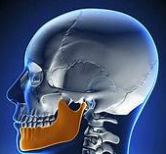
THANK
YOU

